Slide 1
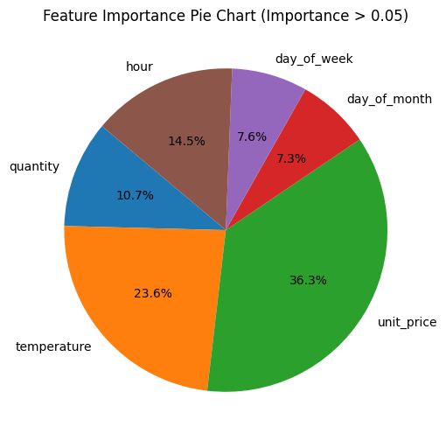
More data is necessary
The accuracy of the model is low (50%) with the current dataset and new features engineered. To test this model for production, more data is needed.
Unit Price is important
Unit price is the most important feature when predicting estimated stock percentages. On the other hand, category is not important (relative importance < 5%).
IoT data is great
As seen in the graph, temperature plays a big part in the prediction of stock percentage. Therefore, we believe that more IoT data will be crucial to increase the accuracy of the model.

